Slide 1

Air Quality Monitoring System Using Arduino
Batch – B2
Guided by
Dr.G.Pandiaraj
Assistant Professor (Sl. Grade)
Electrical and Electronics Engineering

Slide 2
Objective
To detect and monitor the quality of air
To aware people about air quality
To detect harmful gases
To help people respond quickly about changes in pollution level

Slide 3
Motivation
Air pollution – gas pollutants from industries, vehicles – impact on living organisms – harmful diseases
Every year nearly 2.1M people die due to air pollution
To reduce casualities due to air pollution and to protect public health

Slide 4
Tools Required
Arduino Uno
16x2 LCD display
MQ 135 gas sensor
MQ 5 gas sensor
DHT 11 temperature and humidity sensor
Jumper wires
9v Battery
5v buzzer
5mm LEDs
Connecting wires

Slide 5
Block Diagram
MQ 135
LED 1
LED 2
LED 3
Arduino UNO
5v buzzer
MQ 5
DHT 11
LCD display
9V battery

Slide 6
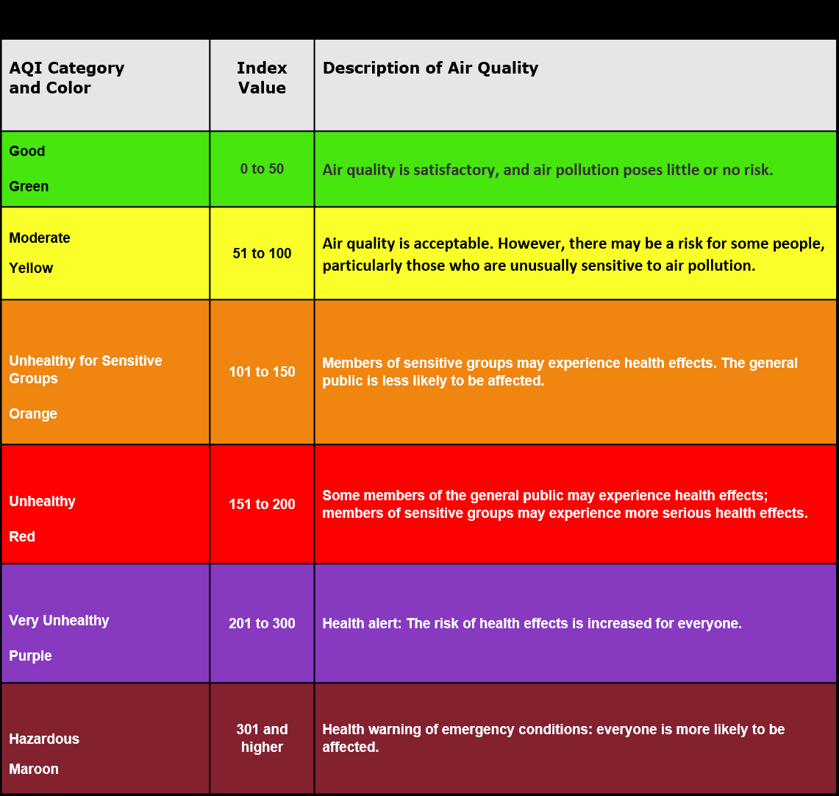

Slide 7
Advantages
Sensors are easily available, low cost and long life
Simple and compact
Detecting wide range of gases
Continuous update on change in air quality
Improved health
Predicting health issues

Slide 8
References
Gunawan, Teddy Surya, et al. "Design and Implementation of Portable Outdoor Air Quality Measurement System using Arduino." International Journal of Electrical & Computer Engineering (2088-8708) 8.1 (2018).
Kanchan, Amit Kumar Gorai, and Pramila Goyal. "A review on air quality indexing system." Asian Journal of Atmospheric Environment 9.2 (2015): 101-113.
Brunekreef, Bert, and Stephen T. Holgate. "Air pollution and health." The lancet 360.9341 (2002): 1233-1242.
Fromme, H., et al. "The German approach to regulate indoor air contaminants." International Journal of Hygiene and Environmental Health 222.3 (2019): 347-354.
Shyam, Shilpa, K. Nath, and Dharam Singh. "Harmful effects of air pollutants in biochemical parameters of plants." Res Environ Life Sci 1.2 (2008): 65-68.

Slide 9
Thank You

